Slide 1

Vel Tech Rangarajan Dr. Sagunthala R&D Institute of Science and Technology
School of Computing
Department of Computer Science and Engineering
10211CS224 / FULL STACK APPLICATION DEVELOPMENT (JAVA)
END SEMESTER PROJECT REVIEW
Date: 06-05-2026
ADVANCED CAREER PORTAL FOR STUDENTS EMPLOYERS
SDG: SDG 9 – Industry, Innovation and Infrastructure
Presented By:
T.Gagan – VTU27292 – Reg.No.23UECS0572
Courses Handling Faculty:
Dr.Mrs.S.Hemamalini
Assistant Professor(Senior grade)

Slide 2
INTRODUCTION
Traditional recruitment and placement processes in many colleges and organizations are still handled manually, making them time-consuming and difficult to manage.Why this project is important
Manual handling of job postings, applications, and candidate tracking often leads to delays and errors.
This project is important because it automates the recruitment workflow through a centralized online platform.
It reduces paperwork, improves efficiency, and helps manage recruitment data more accurately.
The system has real-world relevance for colleges, placement cells, recruitment agencies, and organizations.
Students can create profiles, upload resumes, search for jobs, and apply online.
Employers can post job openings, review applications, and shortlist candidates efficiently.
Overall, the Advanced Career Portal provides a simple and effective digital solution for modern recruitment management.
1
2
3
4
5
6
7
8
9

Slide 3
PROBLEM STATEMENT
In many colleges and organizations, recruitment and placement activities are not fully automated and often rely on manual processes. This leads to inefficiency in managing job postings, applicant data, and recruitment workflows. Students may face difficulties in finding suitable job opportunities and tracking their applications. Employers may experience delays in reviewing applications and shortlisting candidates. Manual recruitment methods can also result in data mismanagement and increased administrative workload. There is a need for a simple, reliable, and automated recruitment platform to streamline the hiring process. The proposed Advanced Career Portal addresses these challenges by providing a centralized digital system for efficient recruitment and placement management.
1
2
3
4
5
6
7
8
9

Slide 4
OBJECTIVE(S)
To develop a web-based recruitment platform that connects students/job seekers with employers through a centralized system.
To automate job posting, application tracking, and candidate management for improving recruitment efficiency.
To provide a secure and user-friendly platform for managing placement and hiring activities digitally.
1
2
3
4
5
6
7
8
9

Slide 5
PROPOSED SYSTEM
The proposed system is a web-based Advanced Career Portal designed for managing recruitment and placement activities digitally.
It provides a centralized platform where students can create profiles, upload resumes, search jobs, and apply online.
Employers can post job vacancies, review applicants, and shortlist candidates efficiently.
The system automates recruitment workflows, reducing manual effort and paperwork.
It improves data accuracy by storing all recruitment information in a structured database.
Application tracking helps students monitor the status of their job applications in real time.
Role-based authentication ensures secure access for Students, Employers, and Admins.
Compared to traditional manual systems, it offers faster processing, better organization, and improved recruitment efficiency.
1
2
3
4
5
6
7
8
9

Slide 6
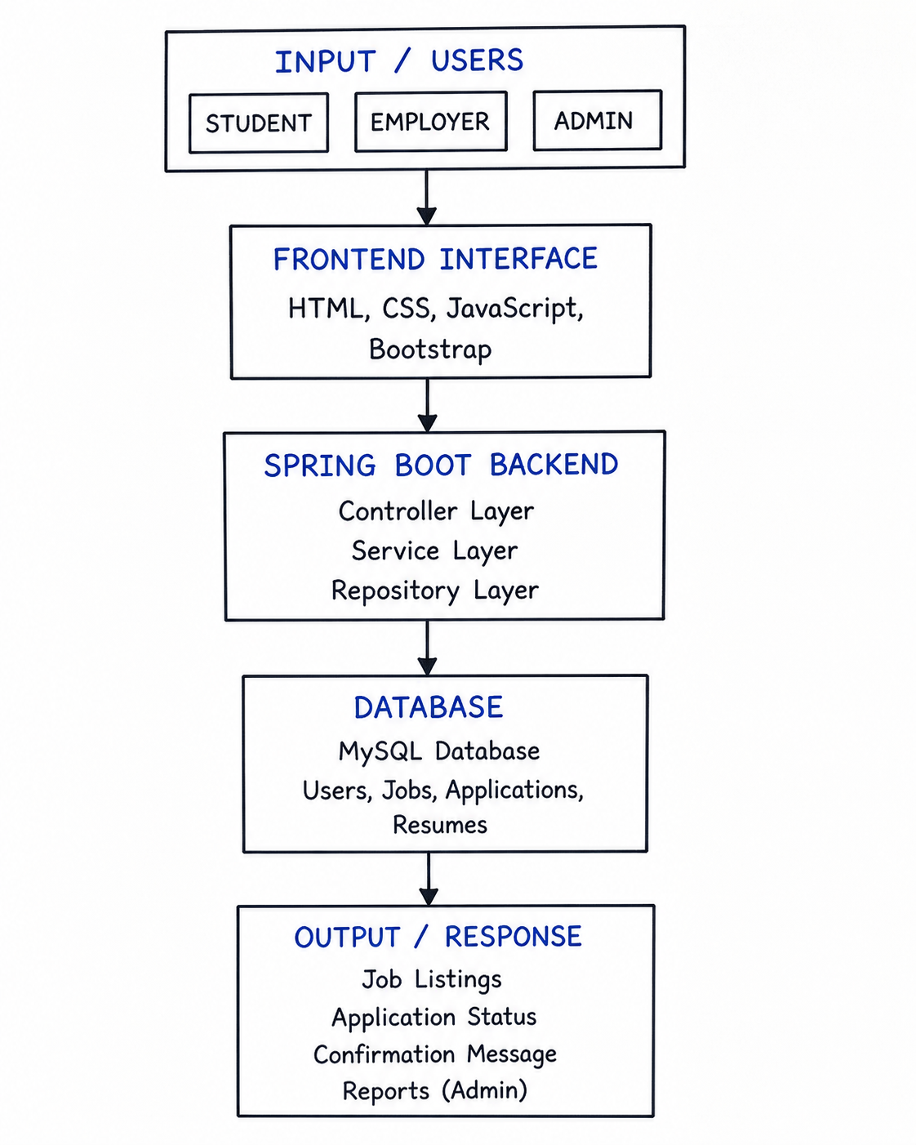
PROPOSED SYSTEM ARCHITECTURE
Input: Students, Employers, and Admins enter details such as login data, job posts, resumes, and applications.
Processing: Spring Boot processes the request using Controller, Service, and Repository layers.
Database: MySQL stores users, jobs, resumes, and application records.
Output: The system displays job listings, application status, confirmation messages, and admin results.
1
2
3
4
5
6
7
8
9

Slide 7
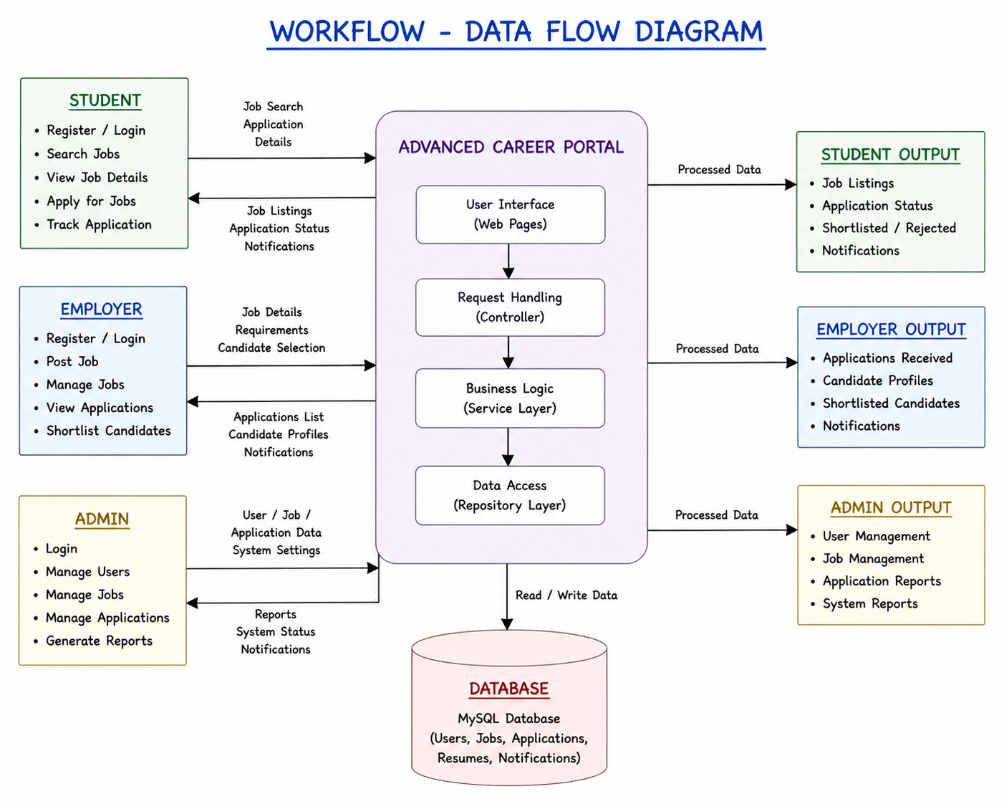
WORKFLOW
1
2
3
4
5
6
7
8
9

Slide 8
TECHNOLOGIES USED
Frontend:
HTML5, CSS3, JavaScript, Bootstrap, Thymeleaf
Backend:
Java, Spring Boot, Spring MVC, Spring Security, Spring Data JPA
Database:
MySQL / H2 Database
Third-Party API:
OTP/SMS API, Map API
Tools:
VS Code, Maven, Postman, Git, Web Browser
Hardware/Software Requirements:
Windows 10/11, Java JDK, Maven, MySQL Server, VS Code, Chrome Browser, minimum 4GB RAM.
1
2
3
4
5
6
7
8
9

Slide 9
MODULE DESCRIPTION
Module 1: User Management
Handles student, employer, and admin registration, login, profile creation, and secure authentication with role-based access control.
Module 2: Job Management
Allows employers to create, update, delete, and manage job postings with details such as title, description, skills, and salary.
Module 3: Application Processing
Enables students to apply for jobs, upload resumes, and track application status throughout the recruitment process.
Module 4: OTP Verification
Implements OTP-based verification and Spring Security authentication to ensure secure user access and prevent unauthorized actions.
Module 5: Reporting & Analytics
Generates recruitment reports, applicant statistics, and placement insights for administrators and employers.
1
2
3
4
5
6
7
8
9

Slide 10
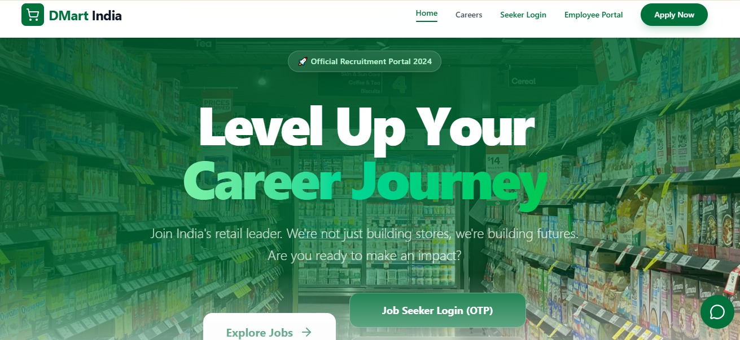
IMPLEMENTATION SCREENSHOTS
Home page:
Displays the landing interface of the recruitment portal with navigation menus and quick access to explore available job opportunities.
Provides users with an attractive overview of the platform and entry points for job search/login
1
2
3
4
5
6
7
8
9

Slide 11
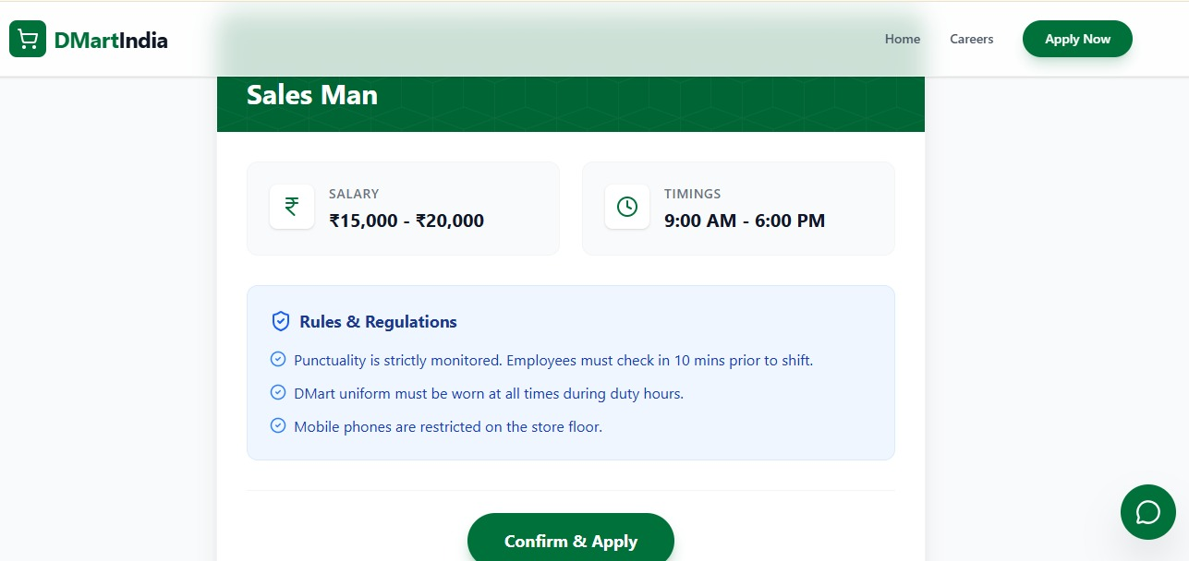
IMPLEMENTATION SCREENSHOTS
Job Listings Page
Shows available job opportunities with details such as title, location, salary, and experience.
Helps users browse and select suitable job openings efficiently
1
2
3
4
5
6
7
8(A)
9

Slide 12
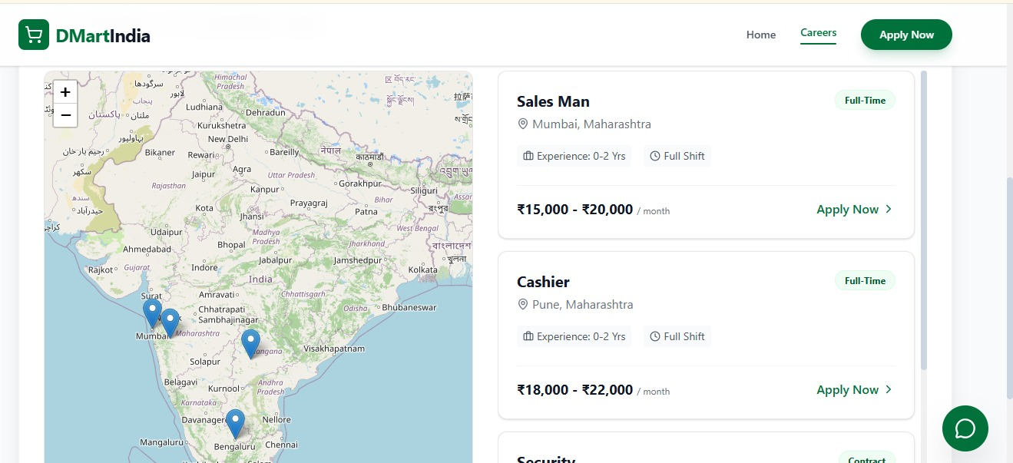
IMPLEMENTATION SCREENSHOTS
Job Details Page:
Displays complete details of the selected job including salary, timings, and workplace rules.
Allows users to review requirements before proceeding with the application.

Slide 13
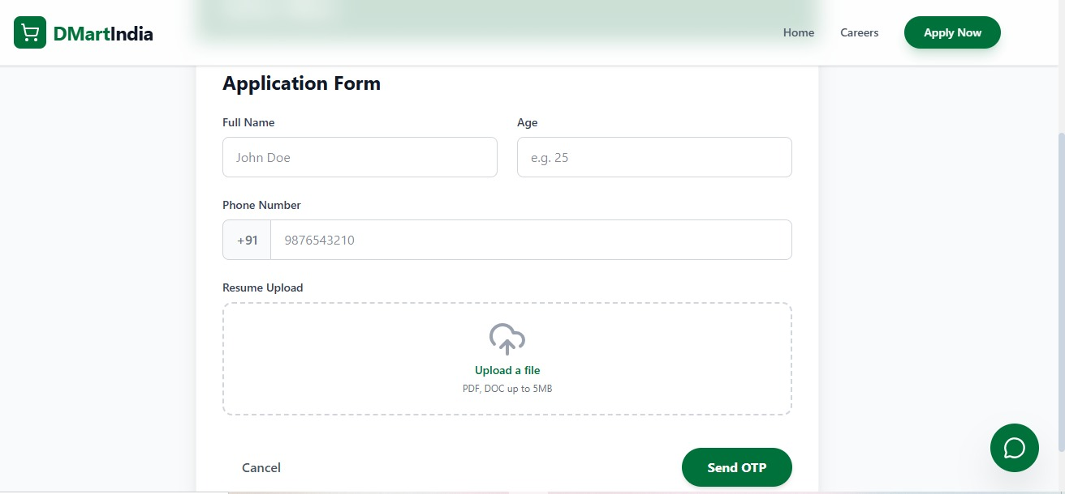
IMPLEMENTATION SCREENSHOTS
Application Form Page
Collects applicant details such as name, age, phone number, and resume upload.
Ensures all required information is submitted before proceeding to verification.

Slide 14
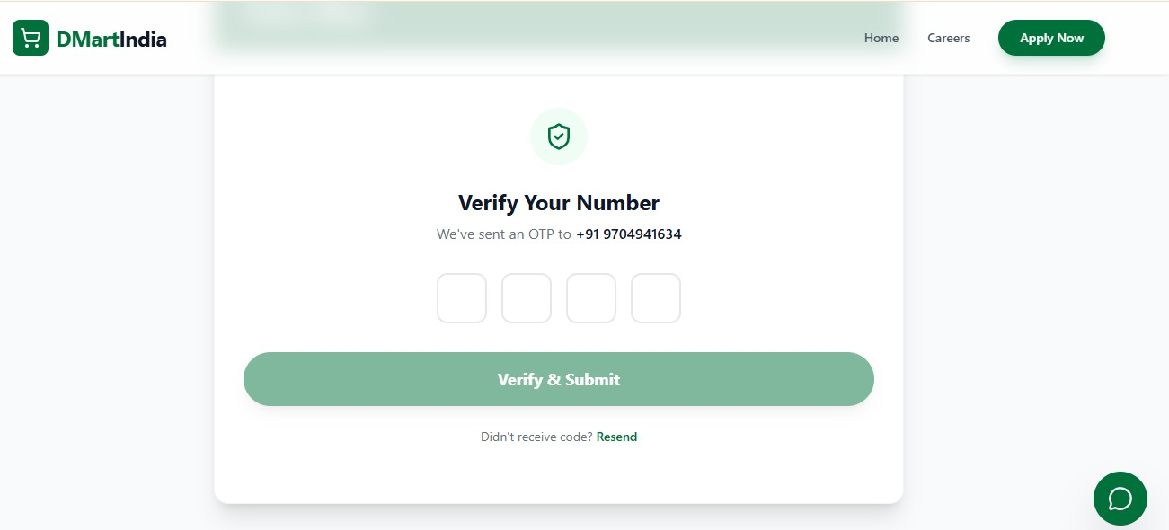
IMPLEMENTATION SCREENSHOTS
OTP Verification Page:
Verifies the applicant’s phone number using OTP-based authentication.
Enhances security and prevents unauthorized application submissions.

Slide 15
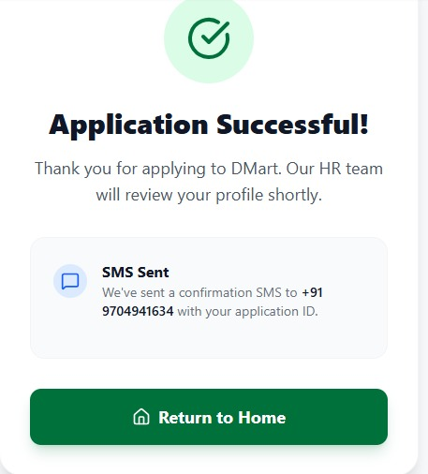
IMPLEMENTATION SCREENSHOTS
Application Success Page:
Displays confirmation message after successful job application submission.
Notifies the user that the application has been received by the HR team.

Slide 16
ADVANTAGES & LIMITATIONS
ADVANTAGES
Automates the recruitment and placement process, reducing manual work.
Provides a centralized platform for students, employers, and administrators.
Enables quick job posting, application submission, and applicant tracking.
Improves data accuracy and reduces chances of human error.
Offers secure role-based authentication for different users.
LIMITATIONS
Requires internet connectivity for system access and operation.
Initial setup and maintenance require technical knowledge.
Limited to web access unless a mobile application is developed.
Advanced features like AI recommendations and interview scheduling are not included in the current version.
1
2
3
4
5
6
7
8
9

Slide 17
Thank you

